Slide 1

Assignment 7.1
Austin Salameh

Slide 2
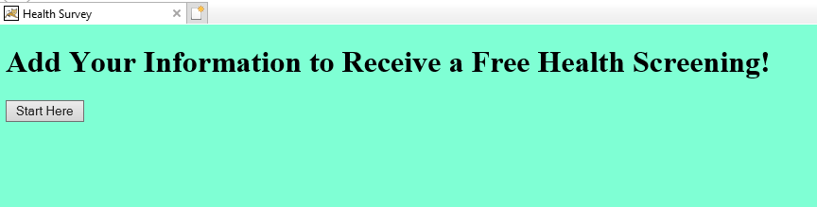
Index Page

Slide 3
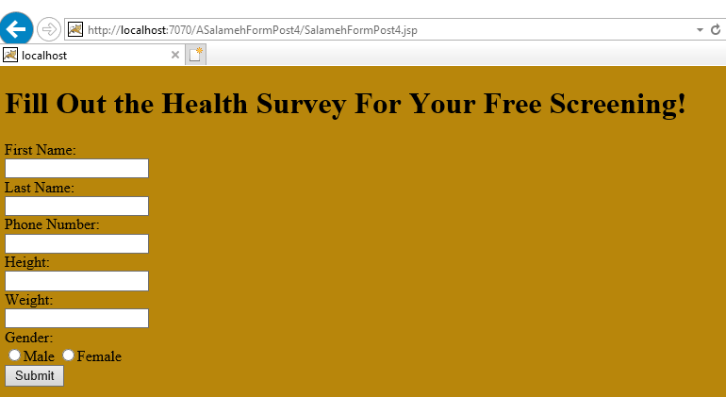
Form Post 4

Slide 4
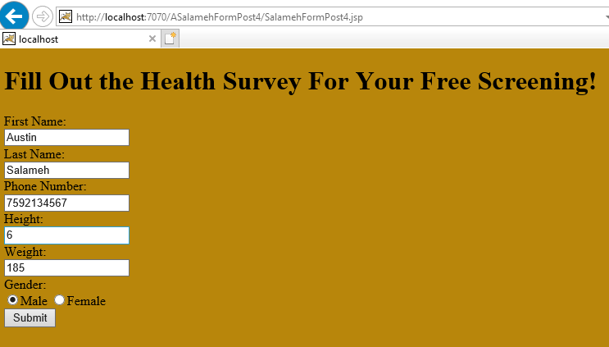
Filled out Form Post 4

Slide 5
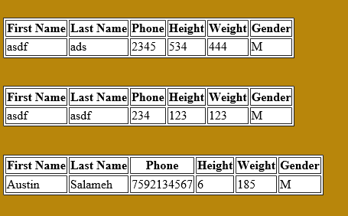
Return from the DB in table form

Slide 6
Issues
Wasn’t getting results from the DB. Simple syntax error such as a missing closing bracket that took me forever to spot… of course.
This video here helped me learn more about what a JavaBean is and why it is important.

Slide 7
Thanks!

